Slide 1




Early integration and holistic approaches for enhanced and interpretable deconvolution algorithms
Bastien CHASSAGNOL
Etienne BECHT (Former Servier, now INSERM)?
Computer sciences
Statistics and
Probability
Pharmaceutical company

Slide 2
Talk layout
Holistic integration
01
Extensions to PLIER? For pathway integration.
Feature-selection and/or Embedding regression
Collaboration perspectives
02
Canada, Hackathon, Workshop, …
Miscellaneous
03
Article projects.

Slide 3
General ideas and exploration tracks
Early integration
MOWGLI and scConfluence
MOWGLI for paired omics
scConfluence for unpaired omics.
MOFA (~probabilistic PCA, multi-omic generalization to EMFA)
NMF (iterated gradient descent and matrix factorization)
Feature selection
Pathway integration
MixOmics: (multi-block) sparse PLS-DA.
…
PLIER (Pathway-level information extractor) algorithm
Add weighted pathway inclusion instead of binary
Data-driven inclusion with CORNETTO
Regression on latent structures, assuming or not that we know the latent structures
GLS (generalized least squares) regression # general linear models (GLM)
Robust regression
Late integration approaches
EpiDISH: call to MASS::rlm() function + posterior unit-simplex constraint
Tracks of improvement: early outlier early discarding, GLS models, unit-simplex constraint…
Modern Methods for Robust Regression, from Robert Andersen + Robust Statistics: Theory and Methods (with R) from Ricardo A. Maronna
EnsDeconv, an ensemblist approach -> Robust and constrained linear regression on the estimates themselves
…
To start with: shared writing
For the HaDaCa 3 challenge
(see published mail)

Slide 4
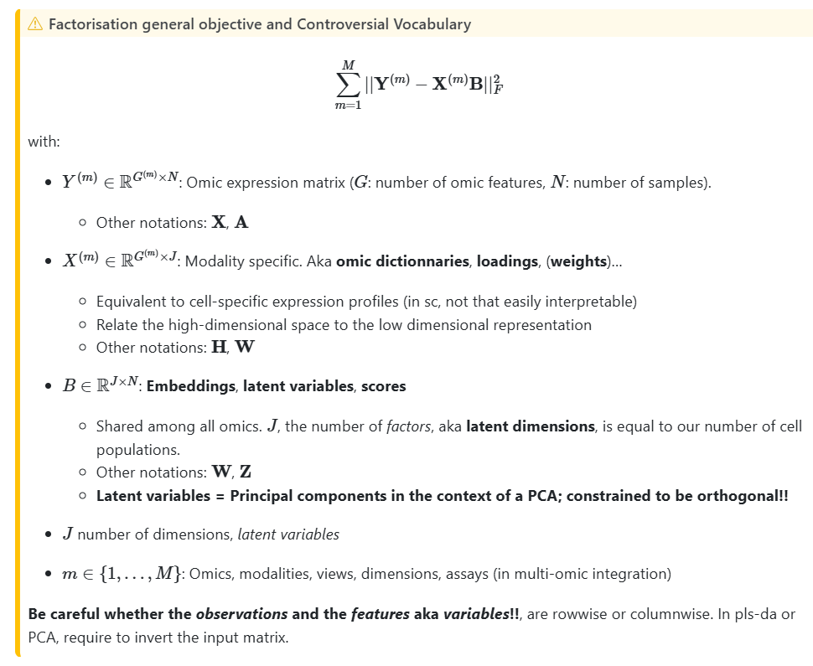
General Modelling Framework

Slide 5
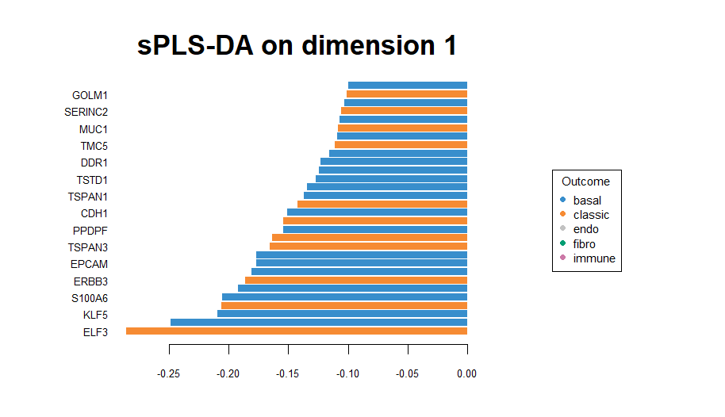
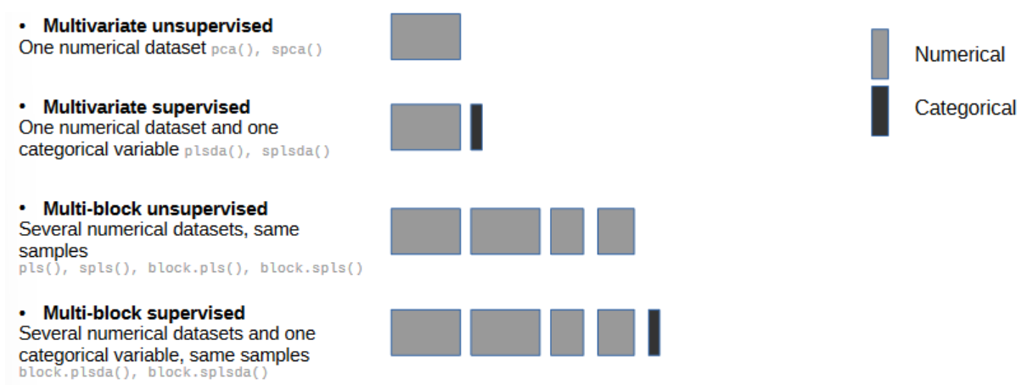
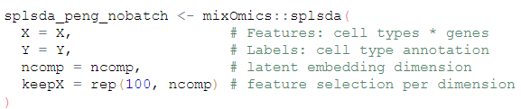
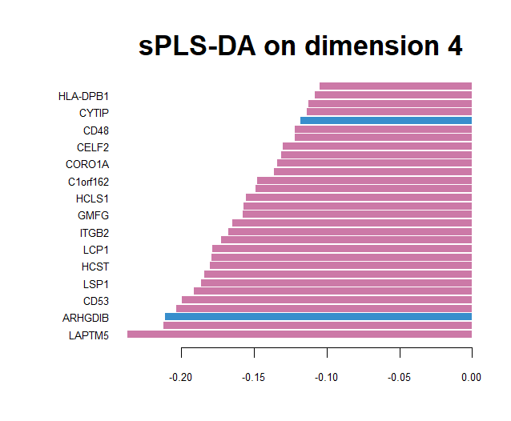
Early integration approaches: feature selection
To be paired with function mixOmics::tune.splsda.
Illustration of mixOmics::s(parse)plsda
Links: https://mixomics.org/mixdiablo/

Slide 6

PLIER pathway integration
+ Inclusion of prior knowledge as pathway binary inclusion (but no weights)
Posterior non-negativity and no unit-simplex constraints
No inclusion of batch effects
No uncertainly evaluation on the latent variables retrieved
Explicitly provide the pathway latent summarised activity?
Useful links:
Original paper: https://www.nature.com/articles/s41592-019-0456-1
R package: https://github.com/wgmao/PLIER (including an extra sparse version?)

Slide 7
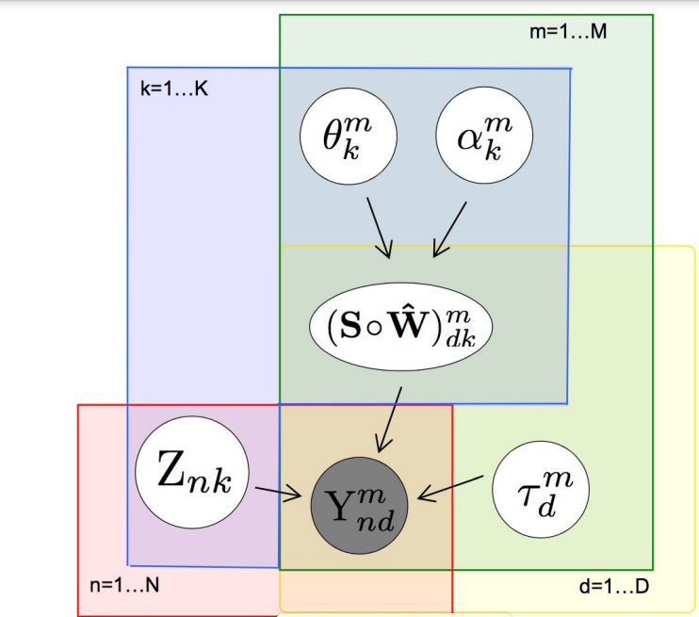
Early integration: MOFA’s matrix factorisation
Probabilistic framework
Underlying Latent Gaussian space
Full probabilistic and Bayesian framework, but uninformative priors
Variational EM inference

Slide 8
Early integration: MOWGLI matrix factorisation
+ Regularisation constraints
+ Probabilistic and use of optimal transport (enforce unit-simplex constraint)
Single cell datasets -> How to generalise on bulk omics?
No use of prior biological knowledge
Side project: migration from Python MOWGLI to R-Mowgli: https://github.com/bastienchassagnol/RMowgli
Useful links:
Original paper: https://www.nature.com/articles/s41467-023-43019-2#Sec9
Theoretical framework: https://proceedings.mlr.press/v51/rolet16.pdf

Slide 9
Late integration approaches
How to consider the RMSE ?
one RMSE by omic ? Average of RMSE of all samples in one omic ?
one RMSE by sample and use it like that for integration ?
what of normalization ?
Estimation prop RNA
Estimation prop met
Weighted mean
Weights
1/RMSE
•Other methods than RMSE -> EnsDeconV
-CTS_EnsDeconv_LS.R -> add documentation
-List (or 3D tensor) of estimated cellular ratios(D experiences * N samples * K cell types)
-Robust regression with unit-simplex enforcing
-Enhanced granularity (cell type + omic category)
-Unexplained hyper-parameters
Submission

Slide 10
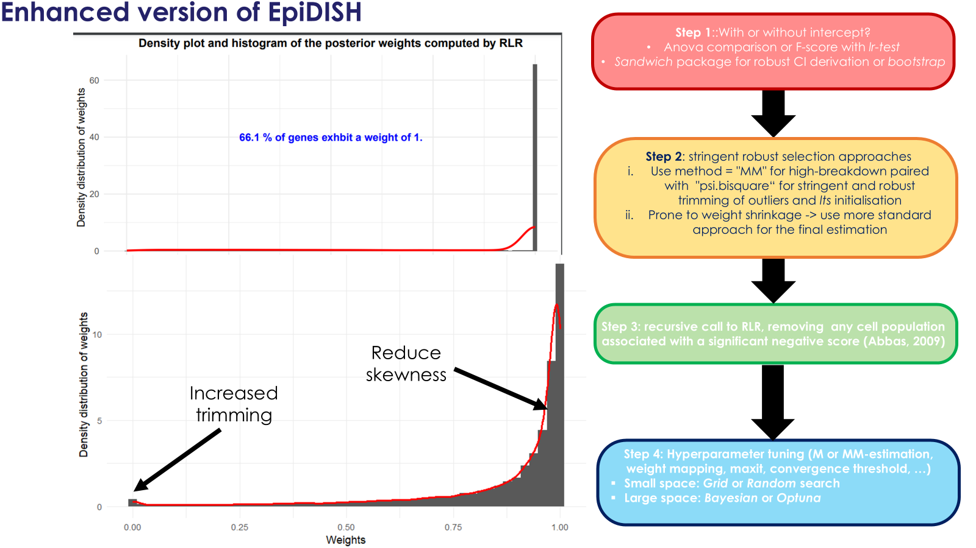
Learning: Epidish and its variants

Slide 11
Academic collaborations
Post-HaDaCa 2025, in close collaboration with Magali Richard, Anaïs Baudot, and Yuna Blum's teams :
HaDaCa 3rd edition paper
EMBO mobility grants, between Francesca Finotello’s lab and Savandara besse, for developing first deconvolution methods applied to Drosophila samples
Organizing a two-day workshop on deconvolution algorithms aimed at non-expert users
Planning a "lightweight" edition of the next HaDaCa challenge, possibly integrated into an existing Hackathon event (such as BioHackathon Elixir or DE.NBI Elixir Hackathons)
Post HaDaCa 2026:
Ambitious workshop, applied for Elixir EMBL-EBI grants:
Day 1: immunedeconv and bulk transcriptome
Day 2: omnideconv and single-cell RNASeq guidelines
Day 3: spacedeconv and spatial deconvolution algorithms.
Day 4: Multi-omics integration + methylation
Day 5: additional free time to run own analyses + DeconvBench + CellTFusion.
Post HaDaCa 2027 (admittedly unrealistic): MSCA COFUND or Staff Grants.

Slide 12
Academic collaborations
France Canada Research Fund: https://vancouver.consulfrance.org/Canada-Research-Fund-2025 + similar grants: https://vancouver.consulfrance.org/IMG/pdf/guidelines-fcrf-2025_en.pdf?7284/759f994afdd0190449bbc7fdc185f6de834abd45
Application reopening on September 9th, 2025 -> closed for this year.
Includes University Laval.
Funds ranging from 8,000 to 15,000 CAD., applications from PIs only
Scientific project must be interdisciplinary, innovative, implying Ph.Ds,
To be paired with l’Oréal Canada + Laura Cantini (l’Oréal Grant for innovative women).
Alternatively, applies for visiting scientific visits: https://vancouver.consulfrance.org/Visiting-Scientist-from-France-2025.

Slide 13
Miscellaneous perspectives
Personal paper projects
Generate first deconvolution algorithms for retrieving the composition of bulk Drosophila samples: https://github.com/bastienchassagnol/DrosophiliaDeconv
Use mixture-model-based filtering approaches followed by comprehensive to compare and evaluate the impact of removing lowly expressed genes on downstream analyses: (https://sites.google.com/view/ascona2025/committees with Mark Robinson and Andrea Rau? Extension of HTSfilter, tailored for bulk transcriptomic, to single cell RNASeq?
Optimise DeCovarT model (generative model, MLE or Bayesian, derive CIs, ..) with Gregory Nuel (or any Canadian or American stat expert, like Rafael A. Irizarry who implemented a mixture Poissong log-Normal based approach termed RCTD for spatial deconvolution, Natalie Rodrigue or Justin Bélair)?
Infer and use GRNs at the cell population level for enhanced and biologically meaningful feature extraction:
Using scRNASeq fingerprints (Laura Cantini, Quentin Blampey, …)
Incorporate prior knowledge and pathway information with Julio? Pablo Rodriguez Miar, Vera and Marcelo?
Multi-omics approaches (Sebastien Dejean avec MixOmics, …)
(Comprehensive benchmark evaluation with Francesca’s DeconvBench benchmark framework + SimBu in collaboration with Hugo Barbot Copula and EFA’s approaches for modelling bulk transcriptomic profiles)

